Slide 1
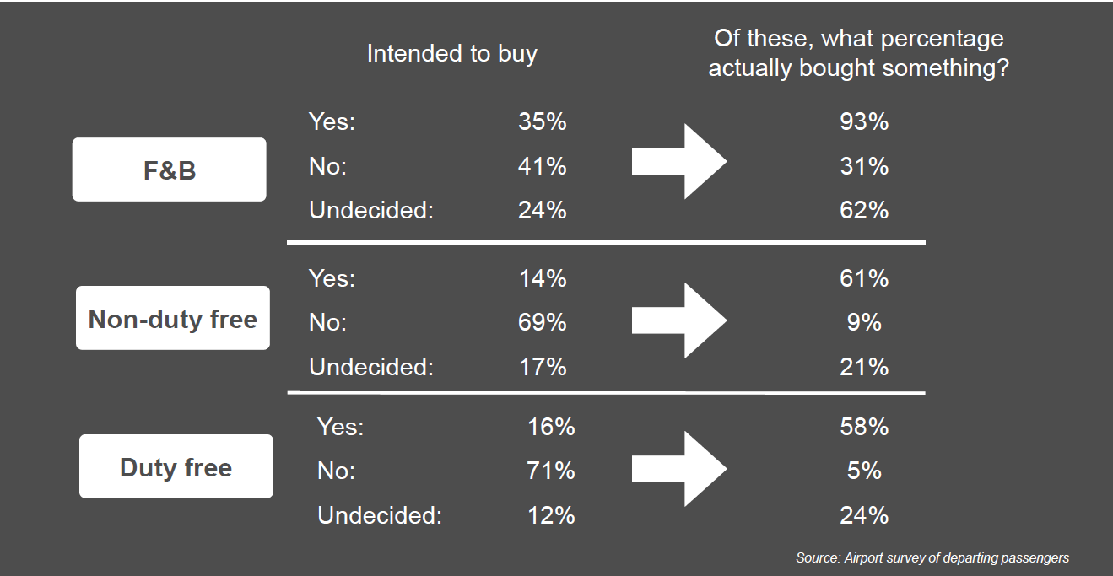
Passenger Survey

Slide 2
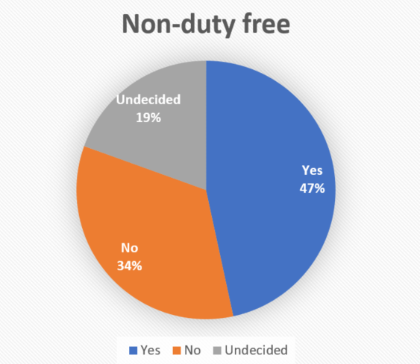
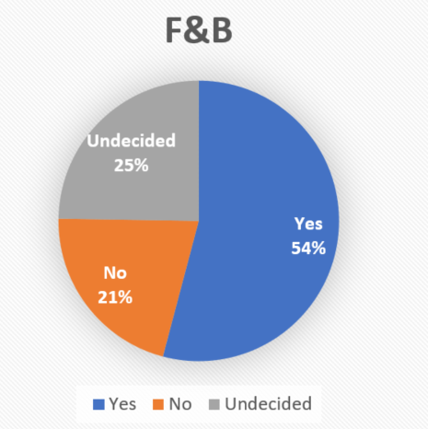
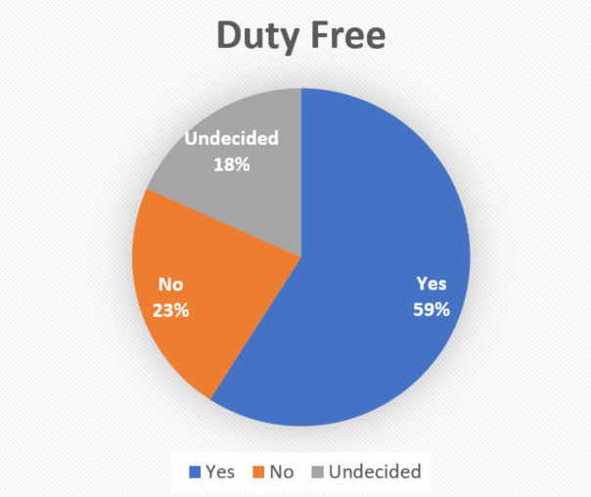
Methodology
Conditional Probability and Bayes' theorem
Calculate the intention (Yes/No/Undecided) of the people who eventually bought at airport based on different good categories
Notes:
F&B: rigid/inelastic demand
Non-duty-free/ Duty free: elastic demand

Slide 3
Insights
“Duty free” and “Non-duty free” are much more elastic market compared with “F&B” since the “No” proportion is much greater than the “Undecided” proportion.
The proportion of “No” plus “Undecided” indicates how good the sales promotion and advertisement of airport shops is.
The “Non-duty free” category is the easiest category airport can improve their sale performance.
Notes:
If the proportion of Yes is 100%, the advertisement and promotions are totally failed.

